Slide 1
MATLAB Hackathon
Group 2 Yash & Helitha

Slide 2
Question 1 - Idea
Many students have 2 problems related to sleep
1. Not getting enough sleep (i.e. less than the expected amount, ~ 8 hours)
2. Not getting good quality sleep (i.e. waking up in the middle of the night, waking up still tired)
Solution: Sleep tracking program for the student to log their sleep duration and quality, and receive corresponding advice

Slide 3
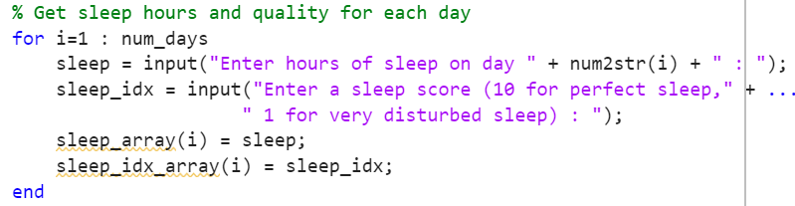
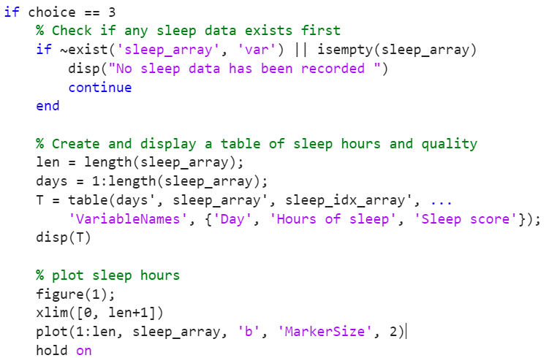
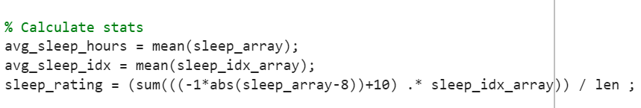
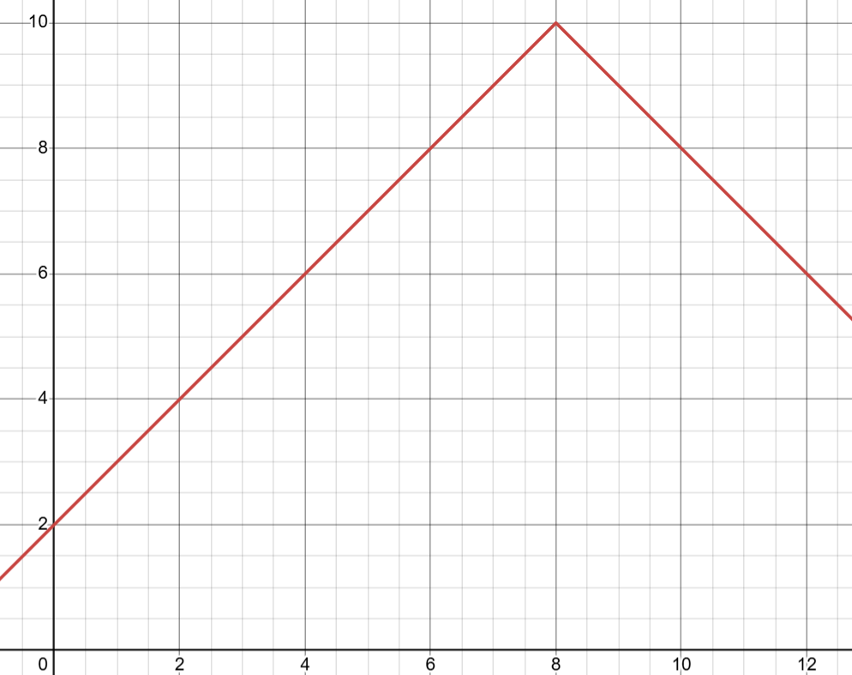
Question 1 – Implementation
We created a menu-driven program where the user can choose one of 4 options:
1. Start a new sleep tracker
2. Add data to an existing tracker
3. View their sleep statistics and receive advice
4. Quit the program

Slide 4
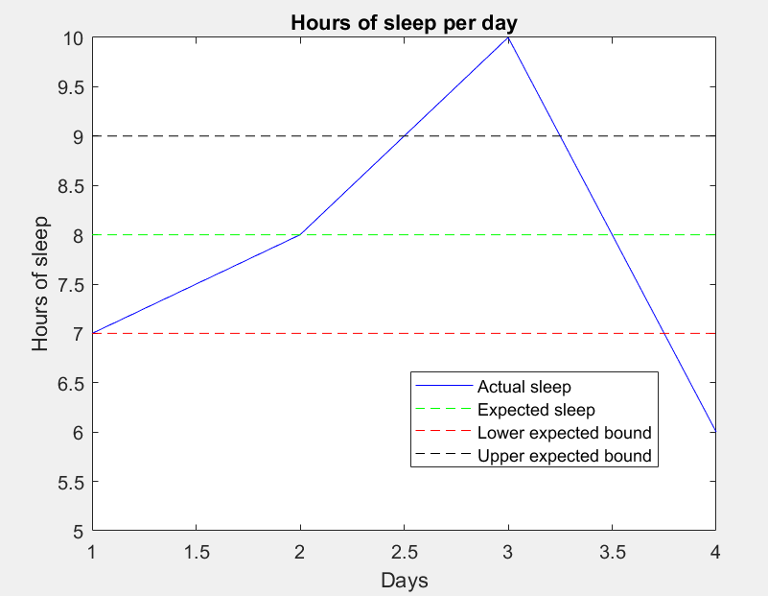
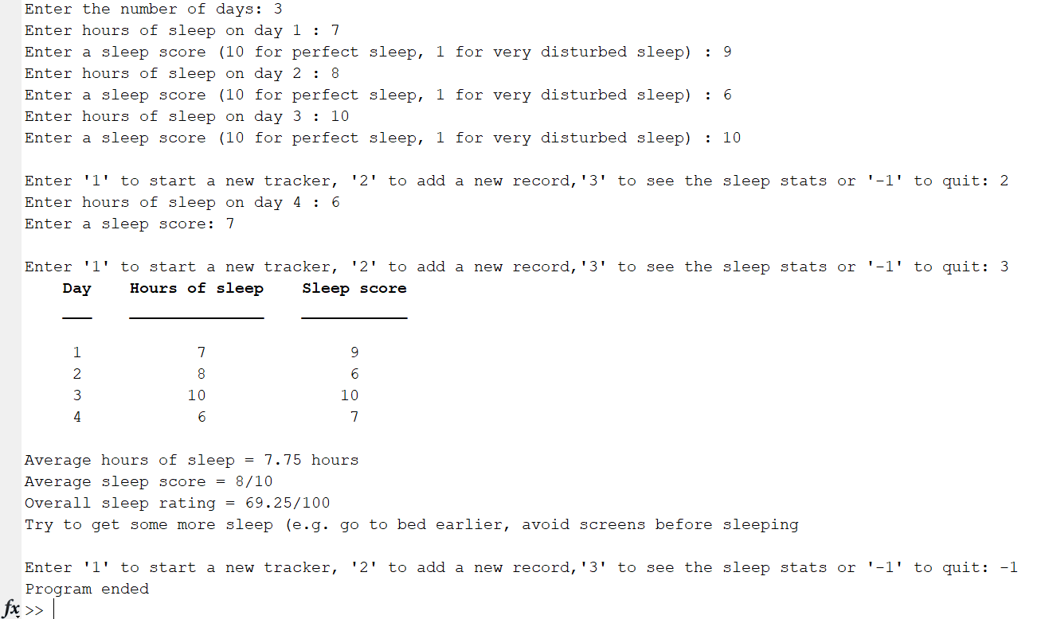
Question 1 - Result
User enters sleep data from scratch
User enters new sleep data
All stats are displayed
Advice given since sleep duration is less than quality
Program terminated

Slide 5
Question 1 - Review
Successes:
We were able to use MATLAB well to create a new sleep tracker, add new data, and display statistics
MATLAB was particularly useful in plotting the graph of the sleep duration in comparison to the expected sleep amount
Challenges:
The user must enter a lot of data so they may not find it very interactive
This could be solved using the MATLAB app designer toolbox

Slide 6
Question 2 - Idea
Many people are getting lazier and lazier nowadays due to social media and digital content
We decided to create a fitness tracker to motivate people to get active
The user can also reliably see which activities burn the most calories so they can adapt their lifestyle accordingly

Slide 7
Question 2 – Implementation
First we plot a 3D trajectory of the route taken during a workout (e.g. while running)
Calculate and display the total distance travelled, and the number of steps completed
Using a low pass filter, we smoothen the velocity graphs for each direction
Internally, we check for data anomalies and ignore them if required
Finally, we use machine learning to classify each activity mode, using the activity data (smoothened) given
We also implemented a threshold-style method to classify activity modes

Slide 8

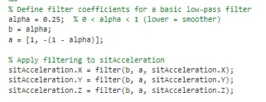


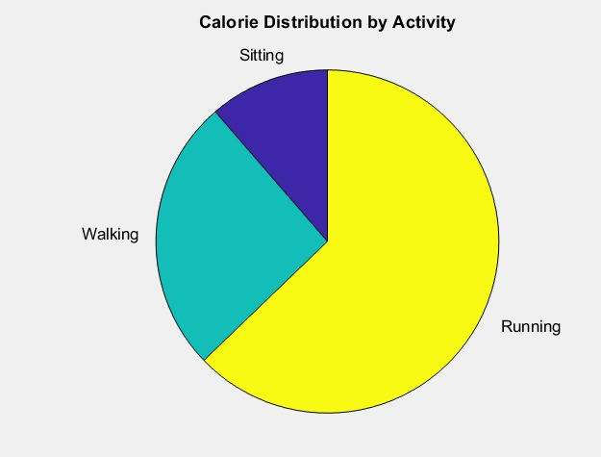
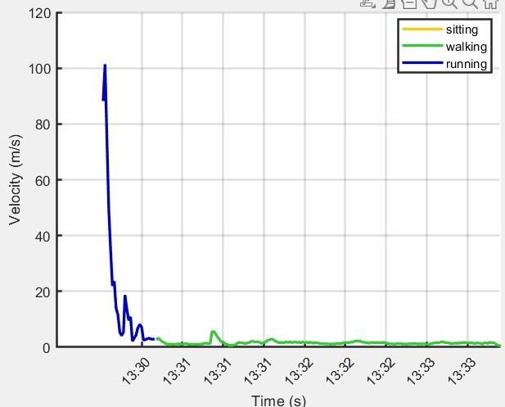
Question 2 - Result

Slide 9
Question 2 - Review
Successes:
Calories, total distance and movement stats are all calculated accurately
Effective filtering of velocity and acceleration data
Challenges:
Applying the trained model to real-life data was not very reliable
Could be due to overfitting, minimized with low alpha value

